Slide 1
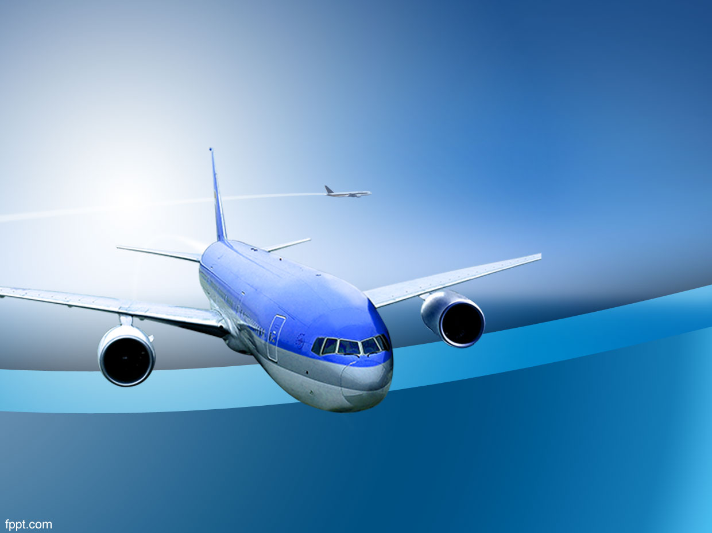
Aviation Safety
Kiran Komati
College of Science and Technology, Bellevue University
DSC 640 – Data Presentation & Visualization
Prof. Catie Williams
10/08/2022

Slide 2
Agenda
Discuss on Media promoted stats
Airline Trends
Airline and Car Fatalities compared
Ways to improve our Airlines
Conclusion

Slide 3
Media promoted reports
Flight journey is not safe
Fatal accidents are on the rise
No. of incidents trend upward
    Let's look at the actual stats

Slide 4
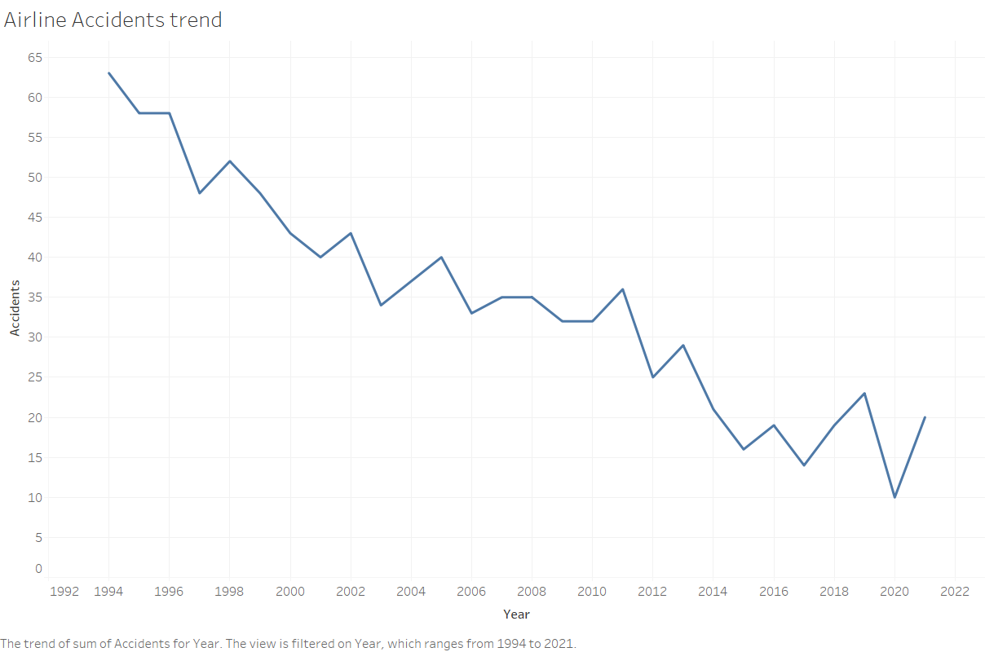
Airline Trends
No. of Airline accidents are on a decline

Slide 5
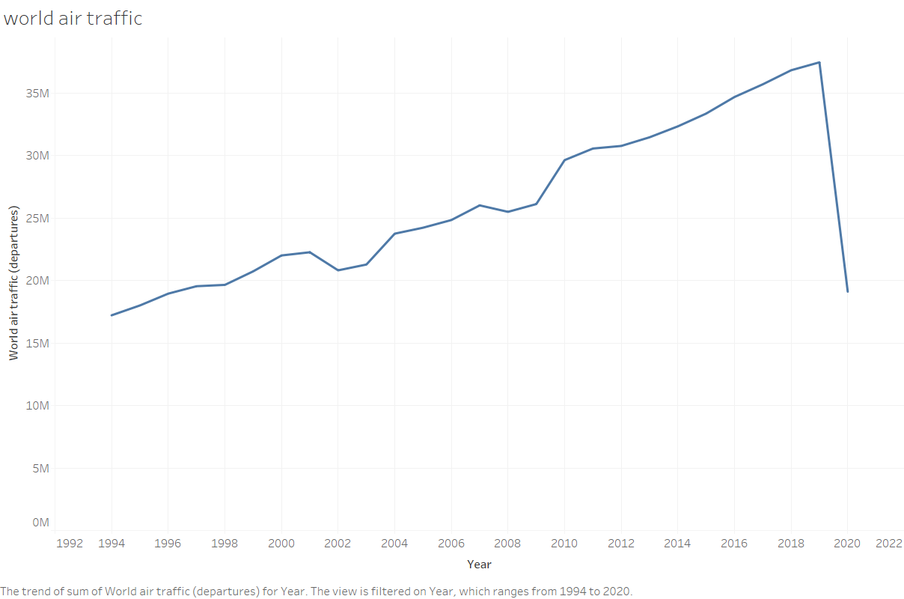
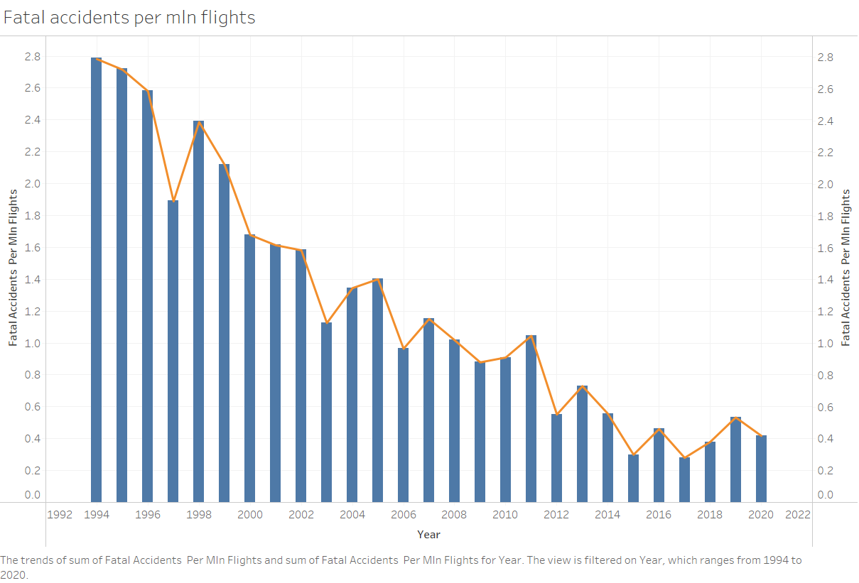
Airline Trends
Air traffic is on the rise(barring covid) whereas fatal accidents has reduced significantly.

Slide 6
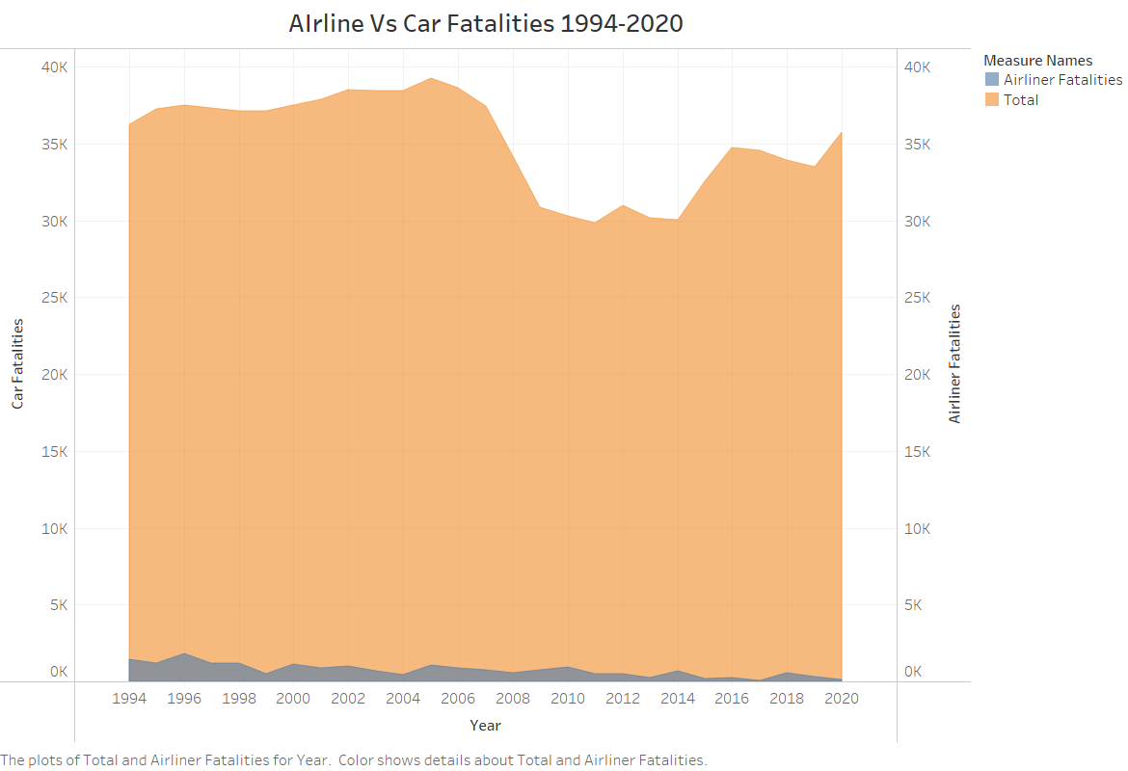
Airline and Car Fatalities compared
Car Fatalities are far more than airline fatalities
Proves Airlines are safer than cars

Slide 7
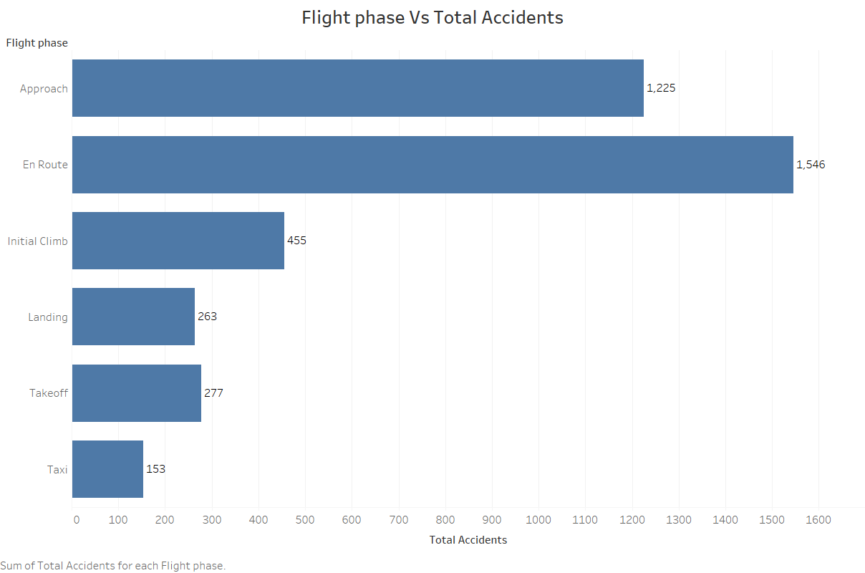
Ways to improve our Airlines
Few phases seem to have more accidents than others
These Need to be considered critical and emphasis to be placed on these phases during training

Slide 8
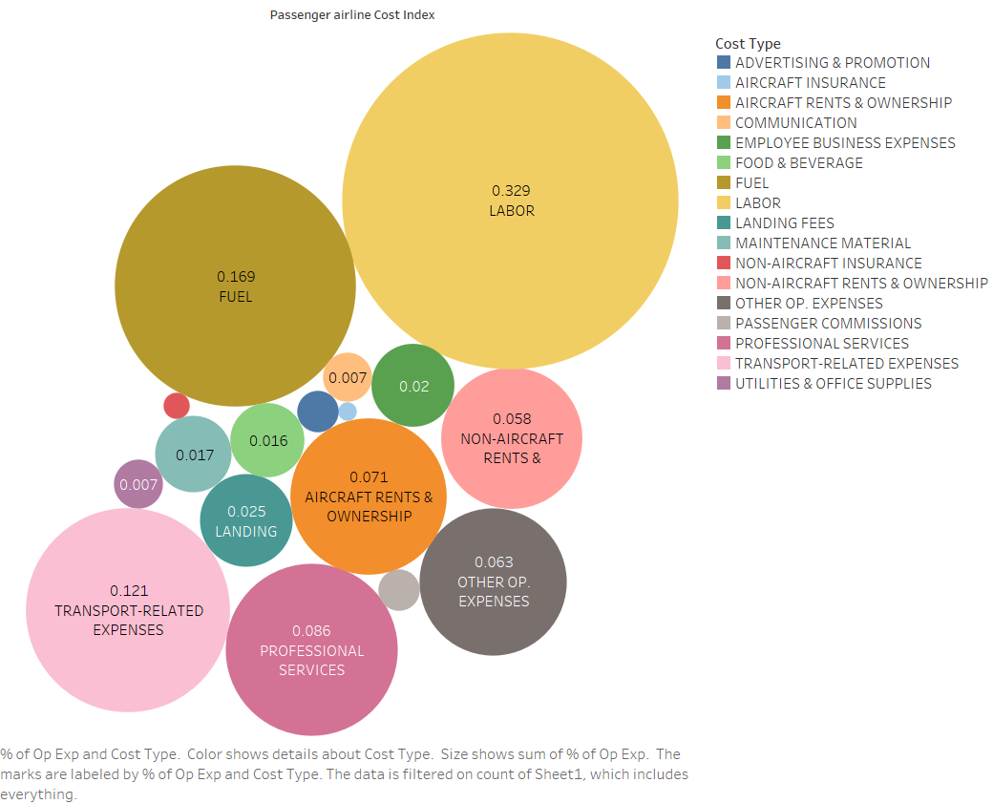
Ways to improve our Airlines
Labor and Fuel costs contribute more to overall cost.
Explore options to modernize and reduce manual costs.

Slide 9
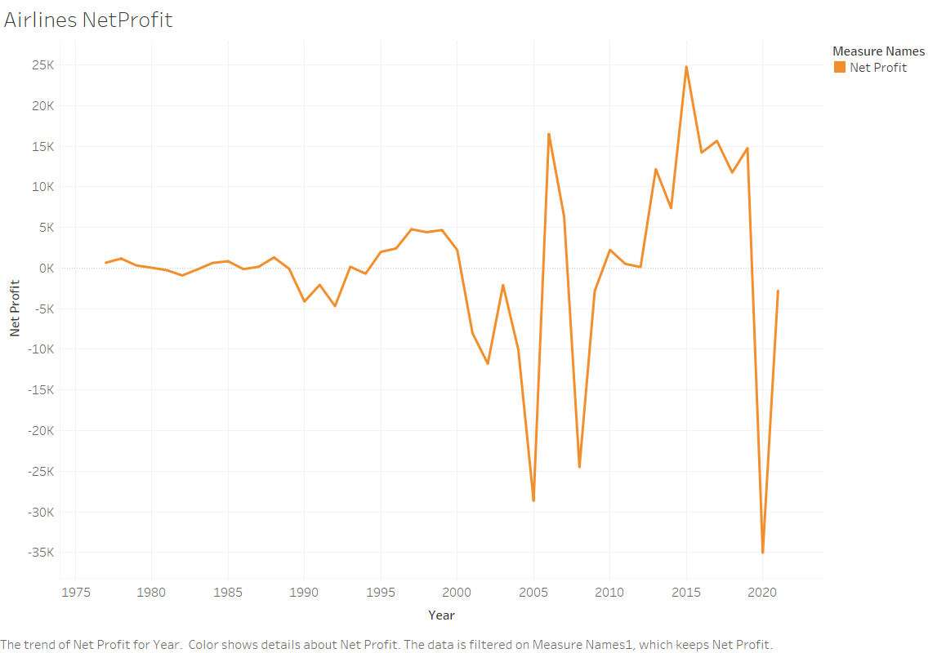
Ways to improve our Airlines
Airlines net profit has started to increase and the post covid restrictions ease and as we come back to normalcy

Slide 10
Conclusion
Actual stats are contrary to what media is portraying
Airline fatalities are far less than car fatalities
Pilots to be trained rigorously on the critical flight phases to reduce accidents further
Explore options to reduce manual costs to maximize income.

